Slide 1


Farmer and Consumer Problems
Farmers travel distances to sell produces
Consumers of Agric Products are unaware about local farmers.

Slide 2
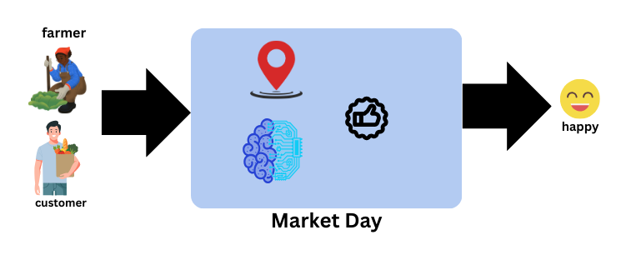

Slide 3
“Market Day” Uniquiness
"Market Day not only focuses on farmer satisfaction, but also prioritizes customer satisfaction.“
Location Based
Smart Recommendation System
Real-Time Chat Functionality
Location-Based Matching
Push Notifications & Alerts
Wishlist Feature
Customer Negotiation Power

Slide 4
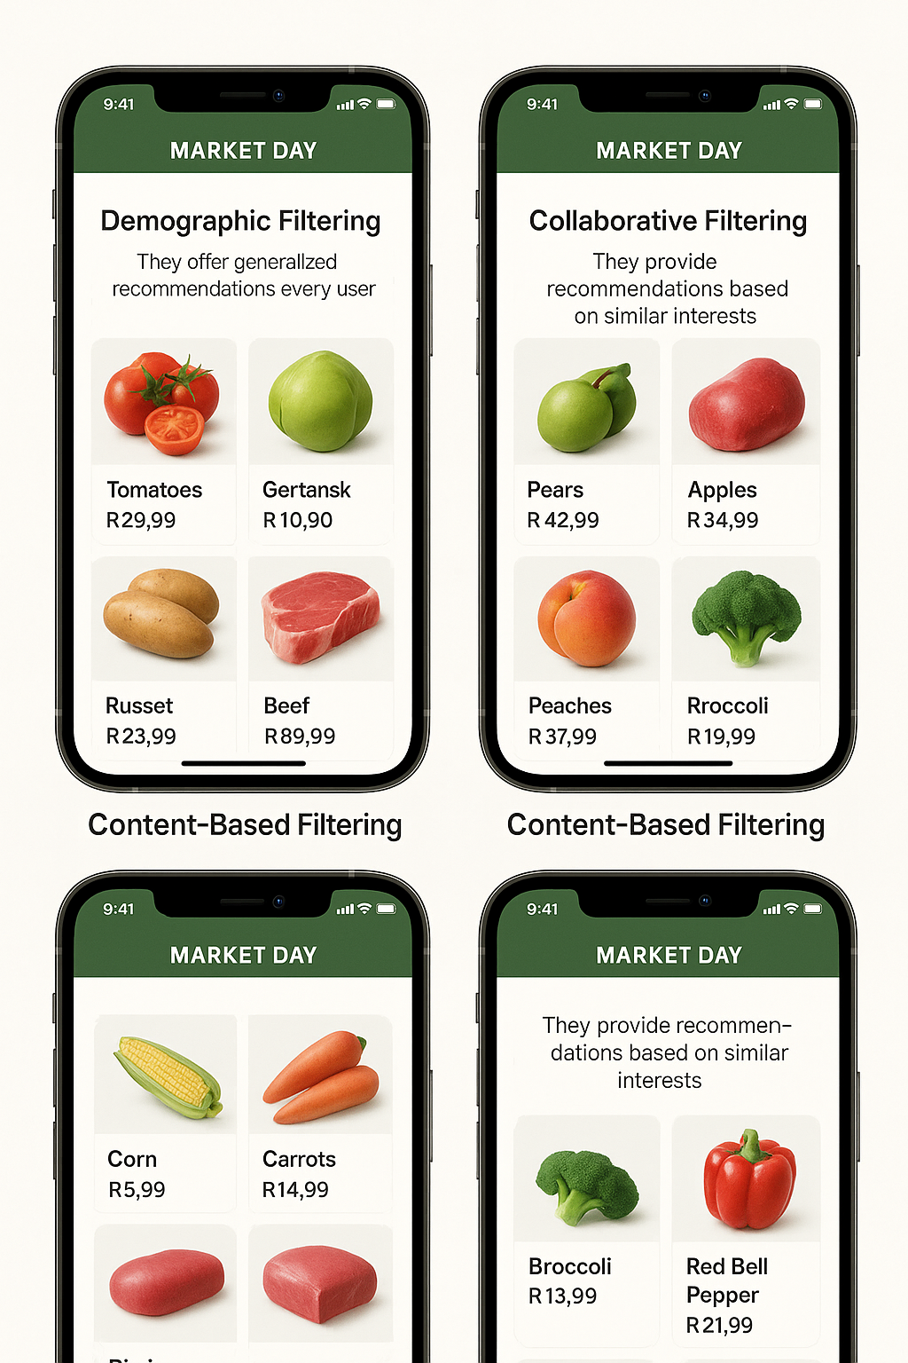
App Reccommentations
Demographic Filtering
Market Day will use basic machine learning to show recommendations to customer based on the popularity and rating of farmers produce. The proposed System should recommends the same Agric products to users with similar demographic features.
Although each user is different , this approach is too simple to implement.
The basic idea behind this system is that Agric products that are more popular and critically acclaimed will have a higher probability of being liked by the average audience.

Slide 5
Reccommentations Cont…
Content Based Filtering
Farmers and customers can add items they like to “wishlist”. We suggest similar items based on a recently added item in the Wishlist and calculate the cosine similarity score between other products using meta data such as seller details, location, product description etc.
The general idea behind these recommender systems is that if a person liked a “green paper”, he or she will also like an item that is similar to it (“red paper”) not “meat”.

Slide 6
App Reccommentations Cont…
Collaborative Filtering
In the event that Meta data is not enough we are going to use Collaborative filters do not require item metadata like its content-based counterparts.
This system matches persons with similar interests and provides recommendations based on this matching.

